Slide 1
BlueChat
Ben Ibasco
Eduardo Pozo
Zorigtbaatar Chuluundorj

Slide 2
Goal
To create a Bluetooth ad hoc messaging network
Achieved milestones
Message ACK, Timestamp, Message Retransmission
Recovering from disconnection
Message History
Bluetooth Scanning on Android 6.0

Slide 3

Message Ack & Retransmission
Message Ack
Old Application
Message Retransmission

Slide 4
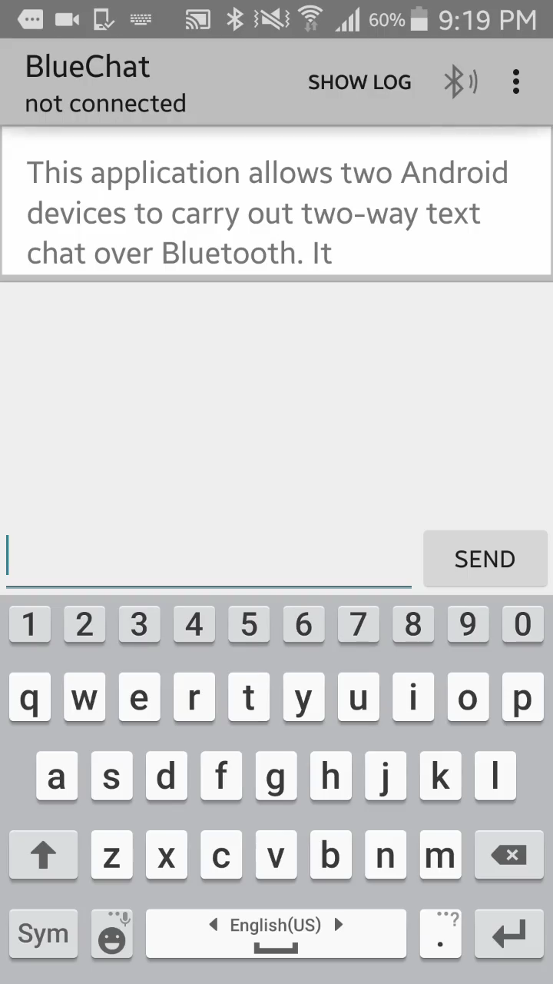
Reconnection

Slide 5
Message Saving

Slide 6
Design Process
Familiarized ourselves with the open source code
Gave each individual a major feature to implement
Made sure that each task could be completed without impeding other teammates progress
Members took ownership of minor tasks to complete as these tasks were identified.

Slide 7
Behavioral Diagram
Connection Behavior
Message Transmission Behavior

Slide 8
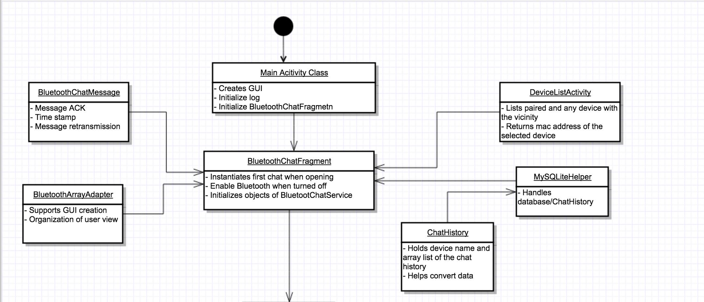
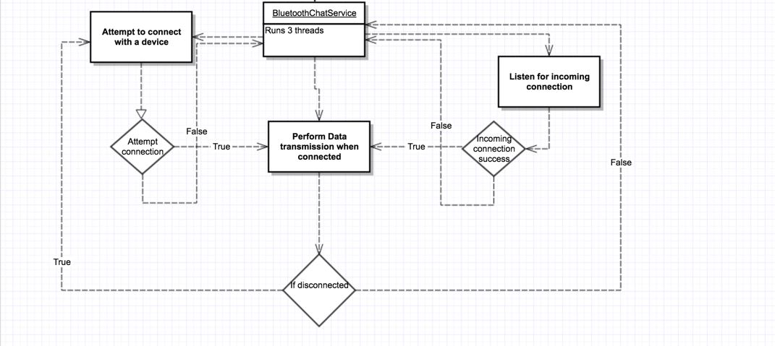
File Structure

Slide 9
Design Mistakes
Ad hoc network is not suitable for Bluetooth
Bluetooth cannot maintain multiple connections unless it is in master slave mode
Disconnecting and reconnecting to another devices takes at least a few seconds

